Slide 1

Pacific Europe NETWORK for Science and Technology
Suva 13th March 2013
10 Good Reasons
to Participate in R& I Programmes
Caterina Buonocore
National Contact Point for Health and JRC
APRE – Agency for the Promotion of
the European Research

Slide 2





Our Mission
Promoting and supporting Italian participation to the
EU Research and Innovation programmes
Improve the “Quality” of the Italian participation in European programs of scientific research and innovation.

Slide 3
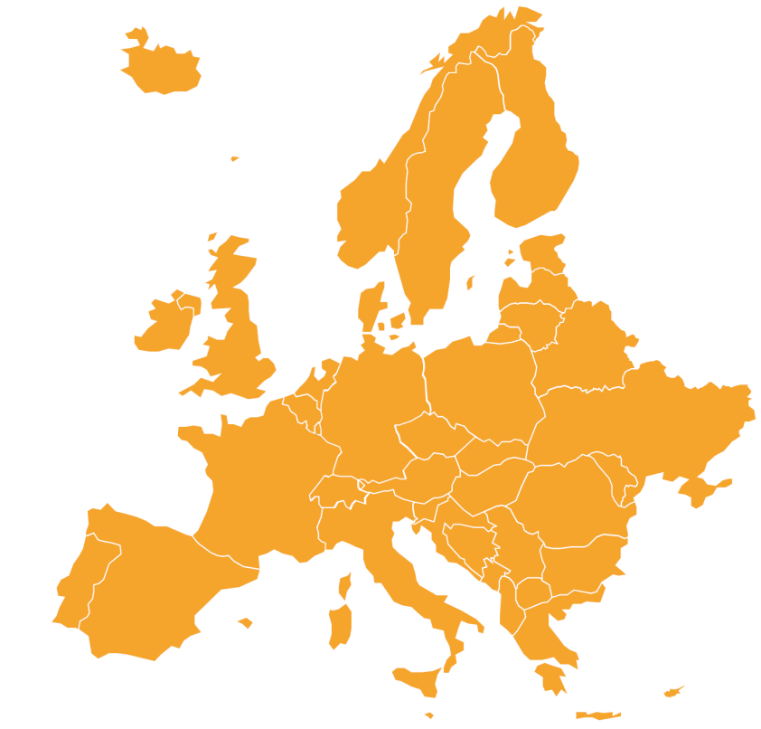
FP7 in Key Figures
79.000 | Applications
386.000 | Participants in applications received
16.000 | Projects funded
85.000 | Participants in projects funded
38% | Universities
28% | Industry (17% SME)
26% | Research Organisation

Slide 4
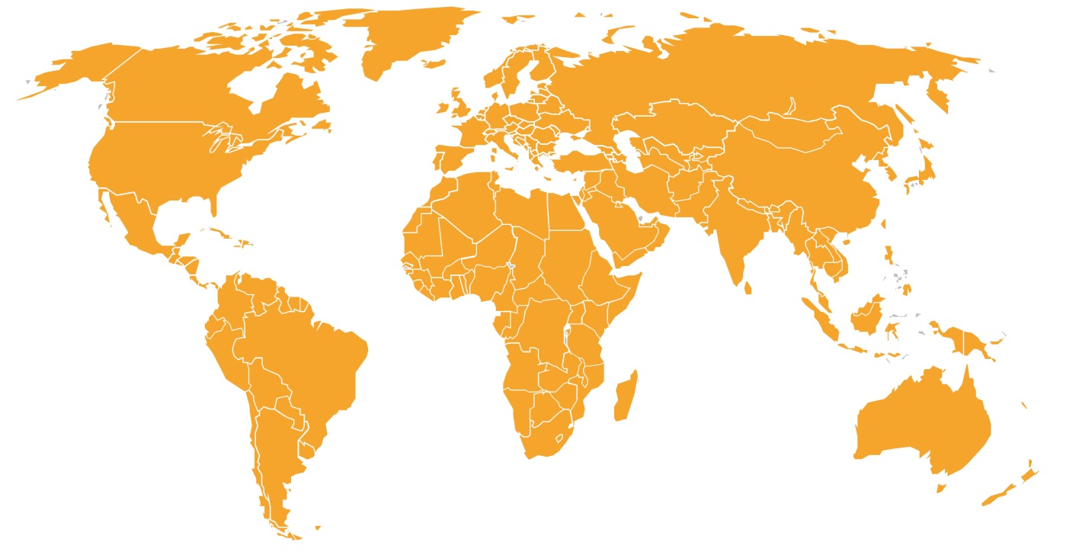
FP7 in Key Figures
169
Countries participating

Slide 5

FP7 in Key Figures
55 Billion € EU

Slide 6
… all research flavours
COLLABORATIVE RESEARCH
International Cooperation
BASIC RESEARCH
MOBILITY
© Fit for Health, 2012
Notes:
Support: Refer to last presentation of the training

Slide 7
How do researchers perceive the EU R&I innovation programmes?
“Jungle” of legal & financial rules and procedures
A huge volume of documents to browse (Work Programme, guide for applicants, evaluation procedures, financial guidelines…)
Partner search is not easy and visibility of Pacific researchers to European researchers is also very little
Matching with research topics
Low Success rate
High costs related to proposals preparation

Slide 8

Worldwide support: ncp networks

Slide 9

10 good reasons to participate in R&I
EU programmes

Slide 10
10 good reasons to participate in R&I
EU programmes
1) Research excellence – build a critical mass – avoid duplication
Promote competition in research and innovation, thereby raising levels of excellence
2) Pooling of expertize – exploit complementarities
Act as a catalyser and for development of common solutions
3) Fruitful collaborations during and beyond the project
Set up of research groups for future projects
4) Sharing of costs-sharing of benefits =
Exploring the transferability of research results
5) Gain international visibility- international marketing
Raise the international attractiveness

Slide 11
10 good reasons to participate in R&I
EU programmes
6) Widening of the range of services
7) Access to research infrastructures
8) Funding
Financial instruments with high leverage and high efficiency
9) Opportunities of trainings
Wide range of training possibilities and enhancement of research and innovation capacities
10) Knowledge sharing
Know-how transfer and sharing at international level

Slide 12
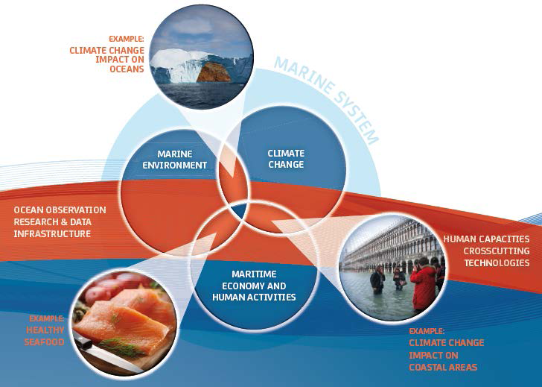
Joint Programming - Oceans

Slide 13
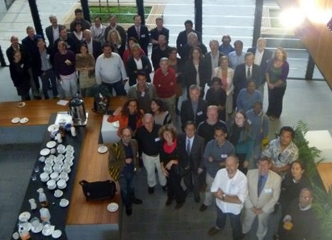
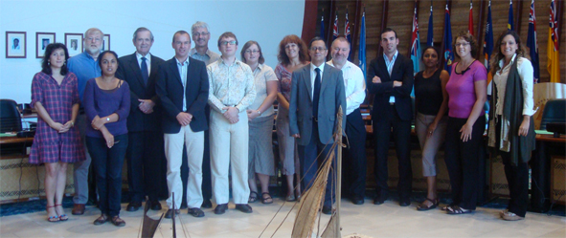
PACE-Net Consortium at the first bi-regional platform (July 2011)
buonocore@apre.it
PACE-Net Consortium at the kick-off meeting (June 2010)

